Slide 1


SMART INDIA HACKATHON 2025
TITLE PAGE
Problem Statement ID: 25002
Problem Statement Title: Smart Tourist Safety Monitoring & Incident Response System using Al, Geo-Fencing, and Blockchain-based Digital ID
Theme: Tourism & Travel
PS Category: Software
Team ID:
Team Name: MAPMINDS

Slide 2

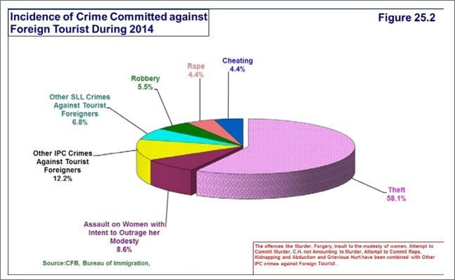
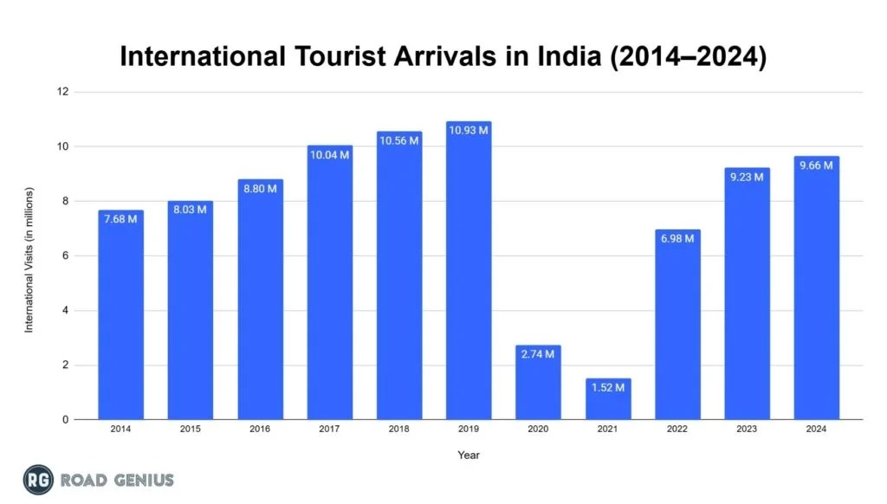
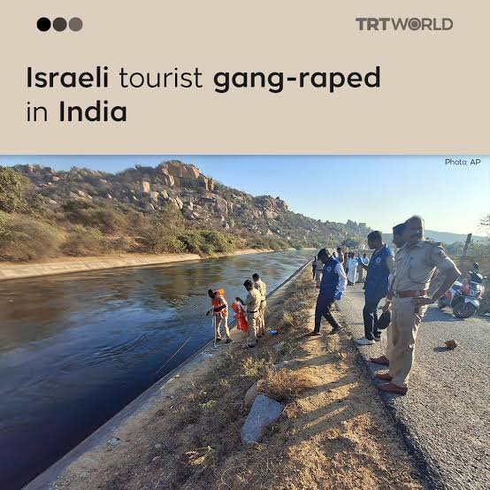
MAP
MINDS
Smart Travel, Safe Journey –
Because Every Tourist Matters
Tourists in India may face:
Scams
Overcharging
Harassment
Poor safety measures
Cultural misunderstandings

Slide 3
Vigilant Voyager
MAP
MINDS
How it addresses the problem: ​
Counters lack of real-time safety info with live AI alerts, overcomes language barriers, and ensures a quick emergency response.
Uniqueness ​of the solution:​
Geo-Fencing (Safe Zones, GPS, CCTNS).
AI Trip Planning.
Exposure to unknown places.
​
​
​
​
Proposed Solution:
​
Tourist safety with AI-powered geofencing for real-time alerts. ​
Blockchain-based digital ID for secure documents AI translation.

Slide 4
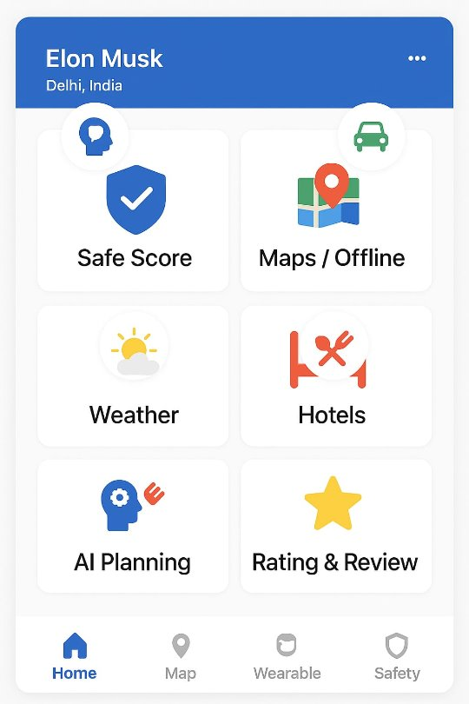
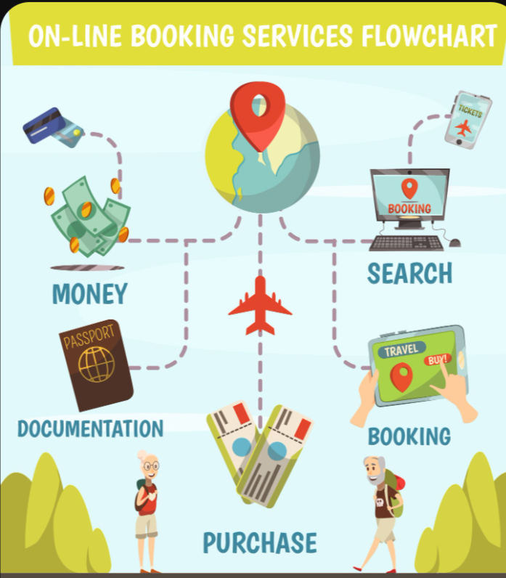
WORK FLOW
MAP
MINDS
Pre-Trip: Creates a secure, blockchain-based Digital ID.
On-Trip: AI and Geo-Fencing send real-time safety alerts and guidance based on their location.
Response: Instant help by sharing their secure Digital ID with authorities.
https://tourist-friendly.vercel.app/​

Slide 5


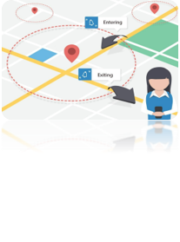



TECHNICAL APPROACH
MAP
MINDS
Safety First​
GPS Tracking​
Geo-Fencing​
Blockchain​
AI Planning​

Slide 6

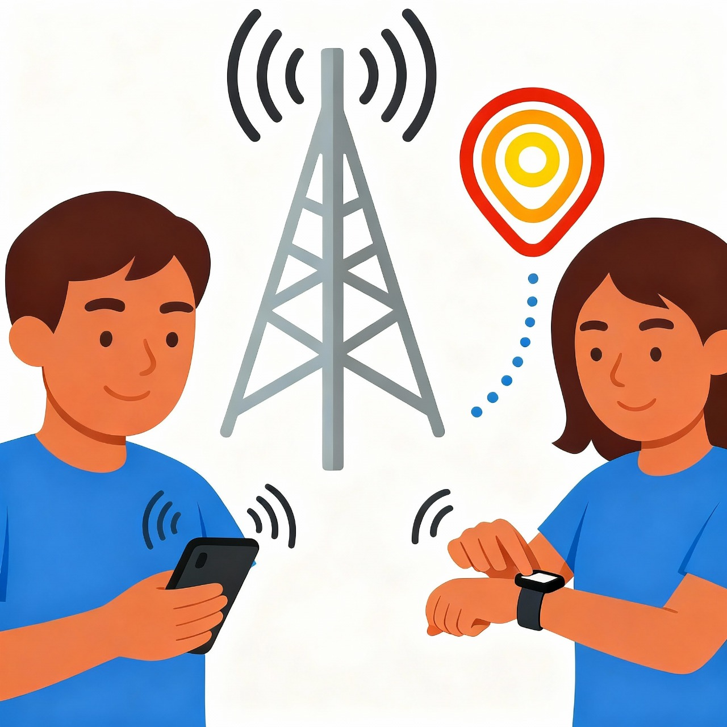
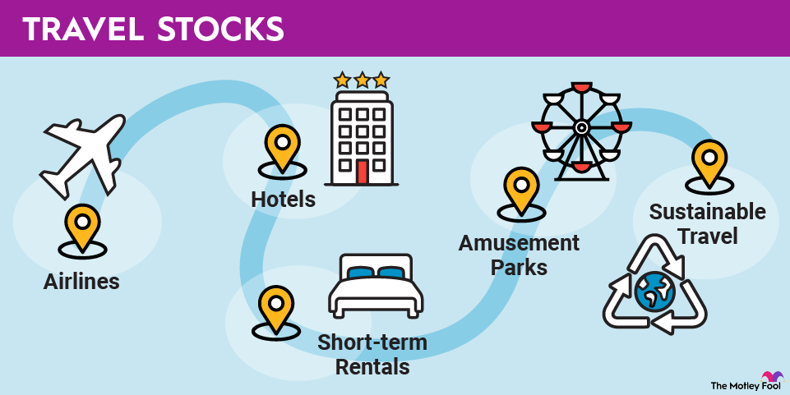



FEASIBILITY AND VIABILITY
MAP
MINDS
Challenges: GPS tracking, offline maps, AI accuracy, user adaptation, breach of data privacy. Overcoming through block chaining, encouraging tourists, storing maps offline.​
Collaborating with Government agencies, technology startups and academic institutions.​

Slide 7






IMPACT AND BENEFITS
MAP
MINDS
IMPACT:​​
Safety as a Selling Point.​​
Increased Revenue & Profitability.​​
Economic & Social Boost.​​
BENEFITS:​​
Elevated Personal Safety & Security.​​
Enhanced Psychological Well-being.​​
Intensified Customer Experience.​​
​
​​
​​
​​

Slide 8


RESEARCH AND REFERENCES
MAP
MINDS
https://sih.gov.in/sih2025PS
https://tourism.gov.in/
https://gemini.google.com/app?hl=en-IN
https://www.data.gov.in/dataset-group-name/Tourism%20Statistics
https://chatgpt.com/

